Slide 1
BluetoothTM Wireless Networking
Presented By
Renaissance Soft Labs

Slide 2
Agenda
Introduction
  What is Bluetooth wireless?
  What can it do for you ?
  How does it compare with other wireless technologies?
  Architectural overview of Bluetooth
  Basic components and network topologies
  Bluetooth protocols
  Security aspects
  Bluetooth profiles
Bluetooth market
  Products and applications
  Bluetooth qualification

Slide 3
What is Bluetooth ?
Bluetooth is a short-range wireless network originally intended to replace the cable(s) connecting portable and/or fixed electronic devices. Such a network is also sometimes called a PAN (Personal Area Network)
Bluetooth is supposed to got it’s name from Harald “Bluetooth” II, King of Denmark 940-981
The concept was first patented by Ericsson. Currently the Bluetooth trade mark is owned by the Bluetooth SIG, a consortium of companies having stake in Bluetooth
Key features are robustness, low power, and low cost.

Slide 4

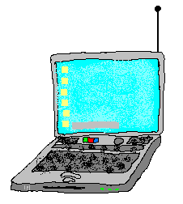

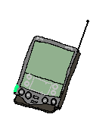



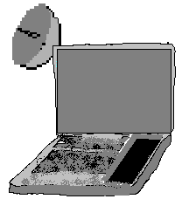

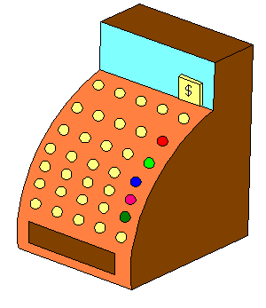
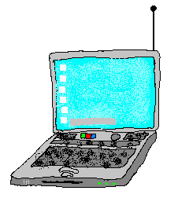

What Can Bluetooth Do For You?
Landline
Cable Replacement
Data/Voice Access Points
Personal Ad Hoc Networks

Slide 5
Comparison with other wireless technologies
802.11
Has higher bitrate compared to Bluetooth . But has higher power consumption. Basic a LAN technology so not a direct competitor for Bluetooth
IrDA
Low cost but require Line of sight. Only point to point
HomeRF
Competing technology. But current Bluetooth is better positioned in market

Slide 6
Bluetooth Architecture
Operates on the 2.4 GHZ ISM Band
Data is transmitted in packets during time slots which are of fixed duration
Connections can be made up to 10 meters or extended up to 100 meters
Maximum speed supported in Version 1 is 1 Mbps
Each Transceiver has a unique 48 Bit Address which is so called as Universal Unique Identity(UUID)
Full Duplex communication is supported through Time Division Duplex (TDD)

Slide 7
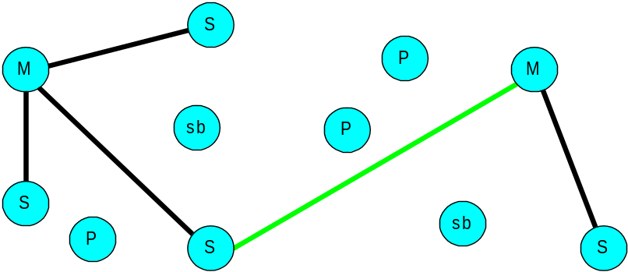
Network Topology
Piconet
  Master can connect to seven simultaneous or 200+ active slaves per piconet
  Each piconet has maximum capacity (1 MSPS)
    Unique hopping pattern/ID
Scatternet
  High capacity system
    Minimal impact with up to 10 piconets within range
  Radios can share piconets!

Slide 8
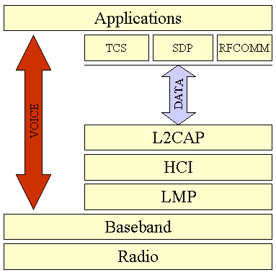
Bluetooth Protocol Stack

Slide 9
Radio Layer
The radio layer is the physical wireless connection
To avoid interference with other devices it uses Frequency Hopping
The standard wavelength range is 10 cm to 10 m, and can be extended to 100 m by increasing transmission power

Slide 10
BaseBand Layer
    It provides transmission channels for both data and voice.
The baseband layer is responsible for controlling and sending data packets over the radio link

Slide 11
Logical Manager Protocol
The Link Manager Protocol (LMP) uses the links set up by the baseband to establish connections and manage piconets.
Responsibilities of the LMP also include authentication and security services, and monitoring of service quality.

Slide 12
Host Controller Interface
The Host Controller Interface (HCI) is the dividing line between software and hardware.
The L2CAP and layers above it are currently implemented in software, and the LMP and lower layers are in hardware
The L2CAP may be accessed directly by the application, or through certain support protocols provided to ease the burden on application programmers.

Slide 13
Logical Link Control and
Adaptor Protocol
The Logical Link Control and Adaptation Protocol (L2CAP) receives application data and adapts it to the Bluetooth format. Quality of Service (QoS) parameters are exchanged at this layer

Slide 14
Bluetooth Profiles
Profiles are basically usage models defined by the SIG to ensure that Bluetooth devices and applications developed by different vendors are interoperable
Some examples of profiles are
File transfer Profile
Dial Up Networking Profile
Service Discovery Profile
Fax Profile
Printer Profile
Head Set profile
Hands free Phone Operation profile
Human Interface Device ( HID) Profile etc

Slide 15
Connection Sequence
Standby
  Waiting to join a piconet
Inquire
  Ask about radios to connect to
Page
  Connect to a specific radio
Connected
  Actively on a piconet (master or slave)
Park/Hold
  Low Power connected states
Unconnected
Standby
Standby
Detach
T
typical=2s
Connecting
Inquiry
Page
States
T
typical=0.6s
Active
Transmit
Connected
data
AMA
States
AMA
T
typical=2 ms
T
typical=2 ms
Low Power
Releases
PARK
HOLD
States
AMA
PMA
AMA
Address

Slide 16
Connection Establishment
Inquiry
PAGE
Connection

Slide 17
Inquiry
Purpose: Looking for Unknown Devices
Responses include:
  Device Address
  Class of Device
A

Slide 18
Paging
Purpose: Establish Connection
Done for each device independently
Paging device becomes master
D
slave D
C
slave C
A
master A
B
slave B

Slide 19
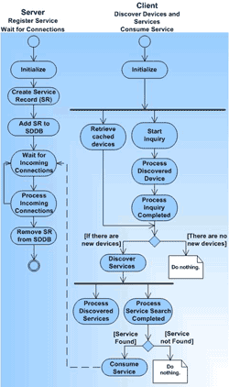

Slide 20
Bluetooth Security
Supports Unidirectional or Mutual Encryption based on a Secret Link key Shared Between Two Devices
Security Defined In 3 modes:
  Mode1- No Security
  Mode 2 - Service Level Security: Not Established Before Channel is Established at L2CAP
  Mode 3 - Link Level Security: Device Initiates Security Before LMP Link is Setup

Slide 21
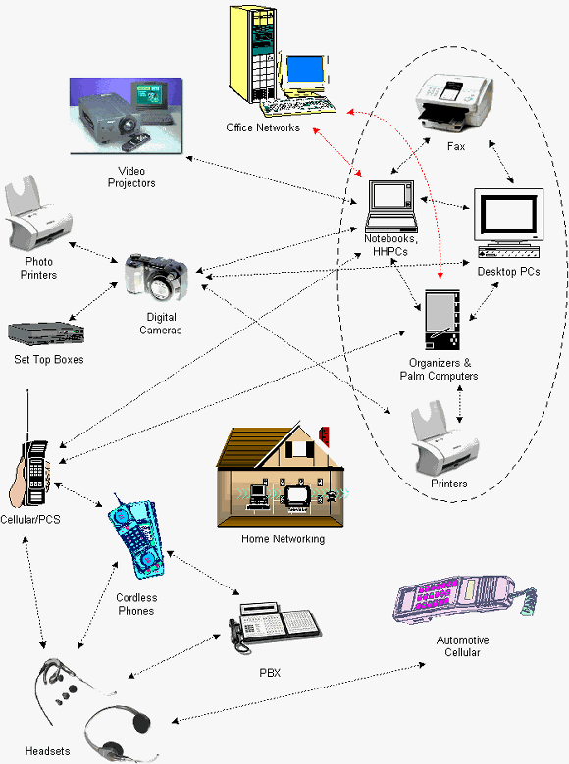
Blueooth Target Markets
The first wave
1. PC, Notebooks
2. Organizers & Palm Computers
3. Headsets
4. Cellular/ PCS
5. Cordless phones
6. Automotive cellular
7. Digital cameras
The second wave
1. Printers
2. Photo printers
3. Fax machines
4. Industrial, musical and vertical industries products

Slide 22
Bluetooth Applications
Universal Vending Machine
Controlling of Devices
Home Automation
Reading e-Mail
Printing the Document in a Hotel

Slide 23
Key Players
Ericsson
IBM
Intel
Nokia
Toshiba

Slide 24
References
www.bluetooth.com
www.bluetooth.org
www.wireless-communication.org/bluetooth/

